Slide 1
Credit Card Fraud Detection
Ali Rifat Kaya

Slide 2
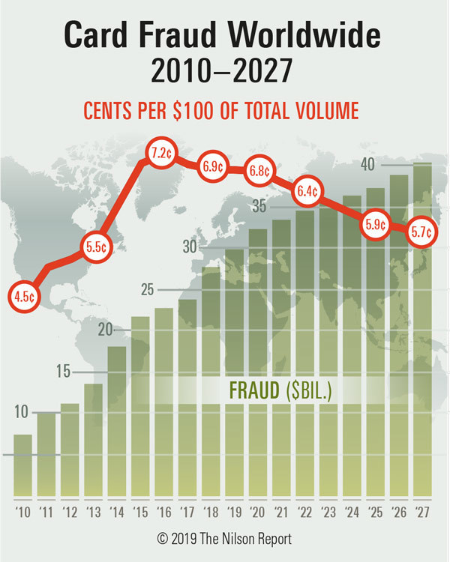
Fraudulent Transactions
For every 100$ genuine transaction, there is a 5.7 ¢ fraudulent transaction.
Does it seem insignificant ?
The amount of fraudulent transactions is expected to reach 40 B. $ in 2027.
Source: The Nilson Report, November (2019)

Slide 3
Fraud Detection
Ideally, businesses want to find ways to prevent fraud from taking place, or, if that’s not possible, to detect it before significant damage is done.
Fraud detection occurs during the fraud attempt.
The goal of fraud detection is to mitigate fraud.
Sophisticated fraud detection solutions also reduce false positives which improves the user experience and increases the productivity of fraud teams
However, the key point is to teach customers how to stay safe:
- Use Safe Payments
- Guard Personal Information
- Check Credit Reports Regularly
- Conduct Online Searches
- Remain Skeptical About Free Trials

Slide 4
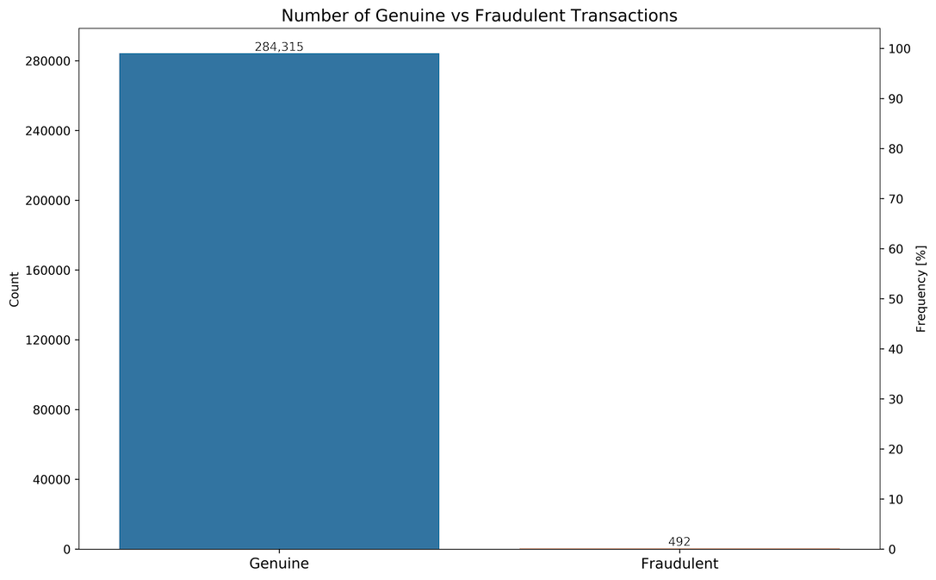
The Data
2 Days of transaction
Collected from Europe
Accounted for privacy
284.407 credit card transactions
Fraudulent to genuine transactions ratio 1:578
The genuine transactions account for 99.83% of all transactions
The fraudulent transactions only account for 0.17% of all transactions

Slide 5
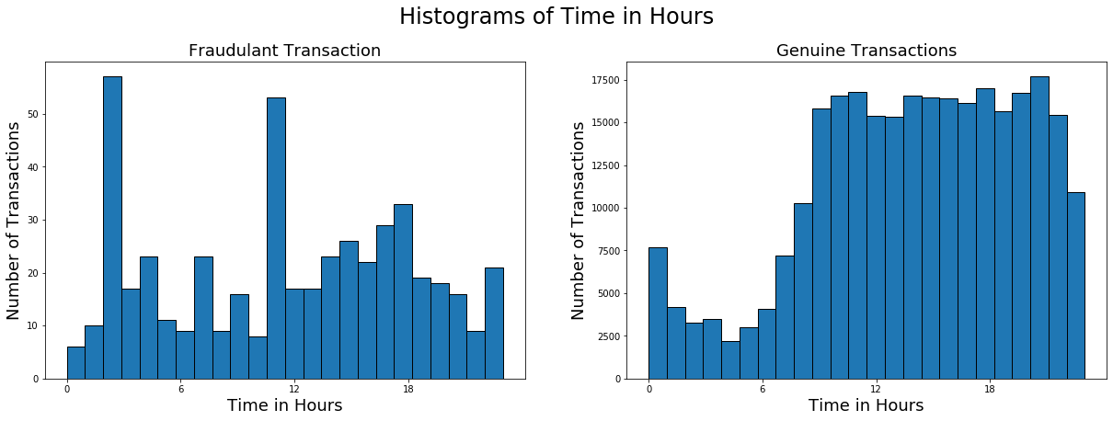
The Data (Continued)
When transactions take place?

Slide 6
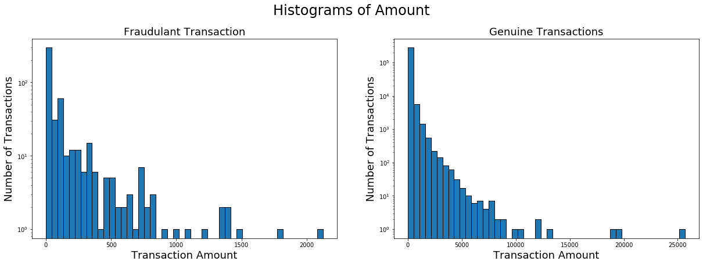
The Data (Continued)
What are the amounts?
Fraudulent transactions mean amount: 122.211
Fraudulent transactions median amount: 9.250
Genuine transactions mean amount: 88.291
Genuine transactions median amount: 22.000

Slide 7
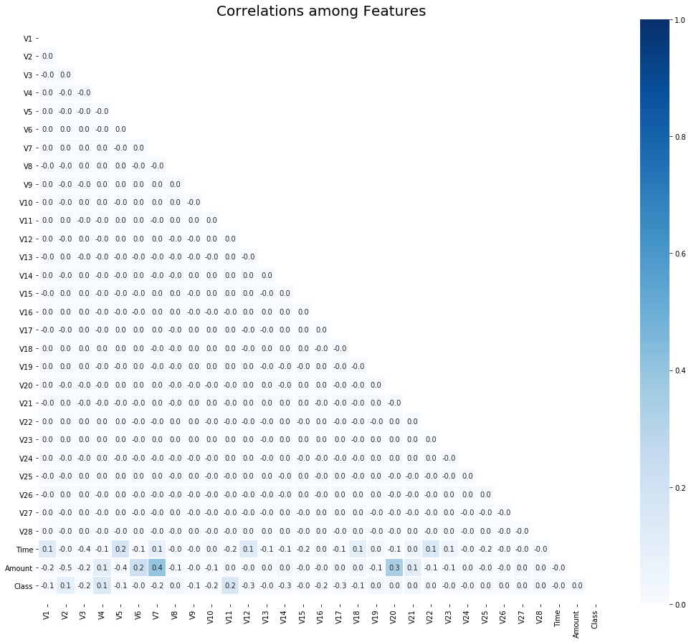

The Data (Continued)
How to detect fraudulent transactions?
Correlation Analysis
There are no patterns among the features (input variables).
Thanks to PCA!!!

Slide 8

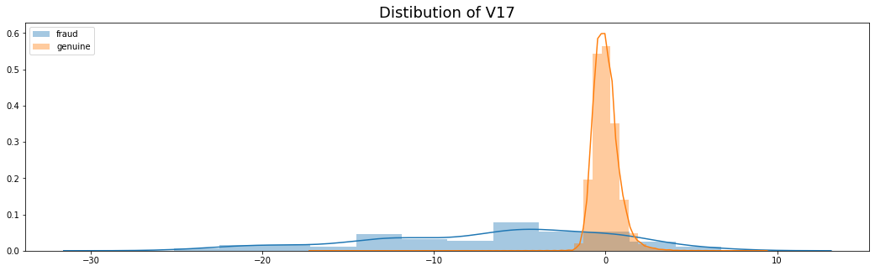
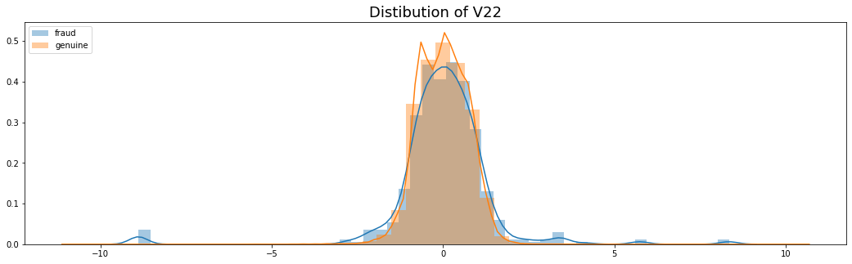
The Data (Continued)
How to detect fraudulent transactions?
A Smarter Way
Bivariate Analysis
Explore each feature by transaction class:
Genuine
Fraudulent
Find the different

Slide 9

The Analysis
Models implemented:
Logistic Regression
K-Nearest Neighbours
Naive Bayes
Decision Tree Classifier
Random Forest Classifier
Extra Trees Classifier
AdaBoost Classifier
Gradient Boosting Classifier
XGBoost Classifier
TOO MANY MODELS ?
Don’t worry - It’s just

Slide 10
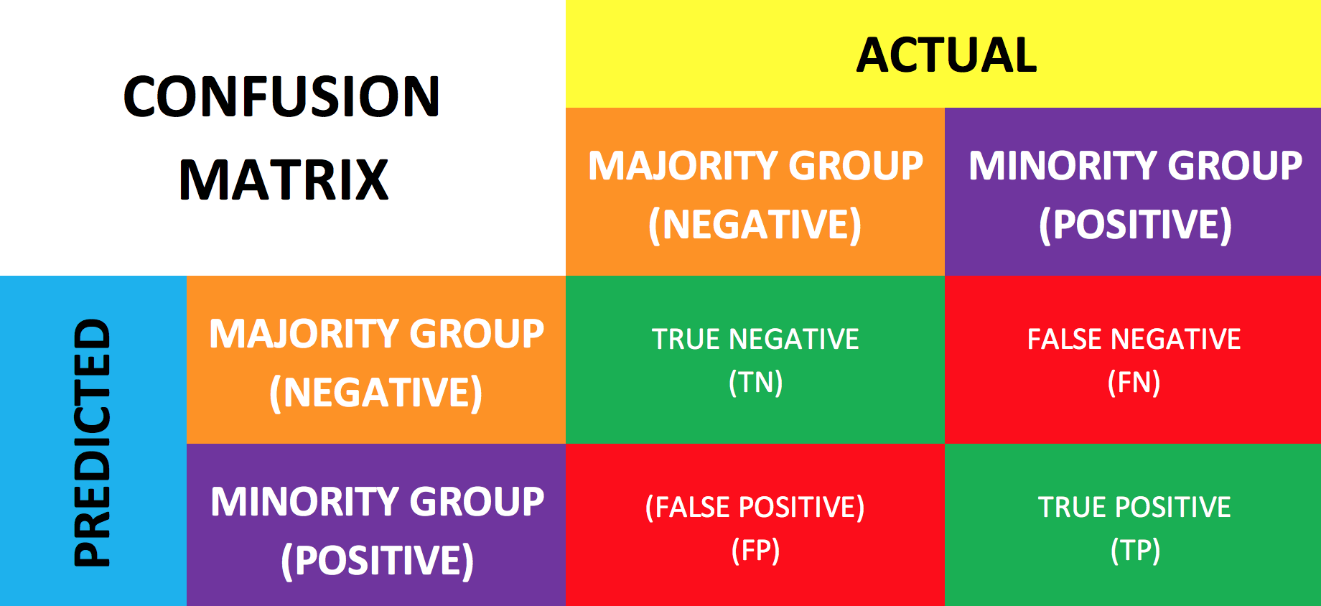
The Analysis (Continued)
The Confusion Matrix - the mother of all metrics
Note: It can be really confusing!!!
TN: Transactions that are genuine and predicted to be genuine
FN: Transactions that are fraudulent but predicted to be genuine
FP: Transactions that are genuine but predicted to be fraudulent
TP: Transactions that are fraudulent and predicted to be fraudulent

Slide 11
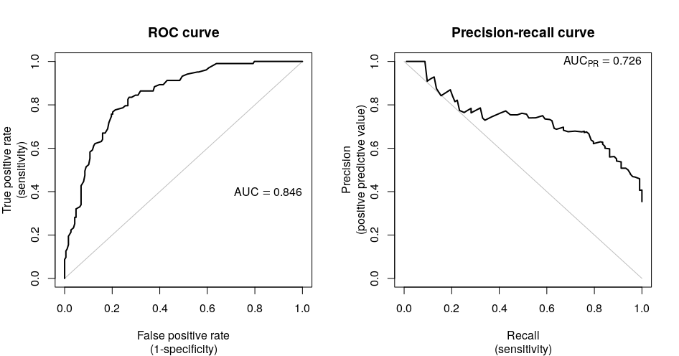
The Analysis (Continued)
Easy to see the trade-off:
Detecting all fraudulent transactions may not be the best answer
Easy to interpret:
Higher score better model

Slide 12
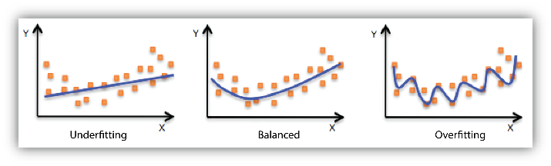
The Analysis (Continued)
Overfitting and Underfitting - finding the balance
Overfitting: the model works only well with the data in hand
Underfitting: the model does not successfully capture the patterns in the data

Slide 13
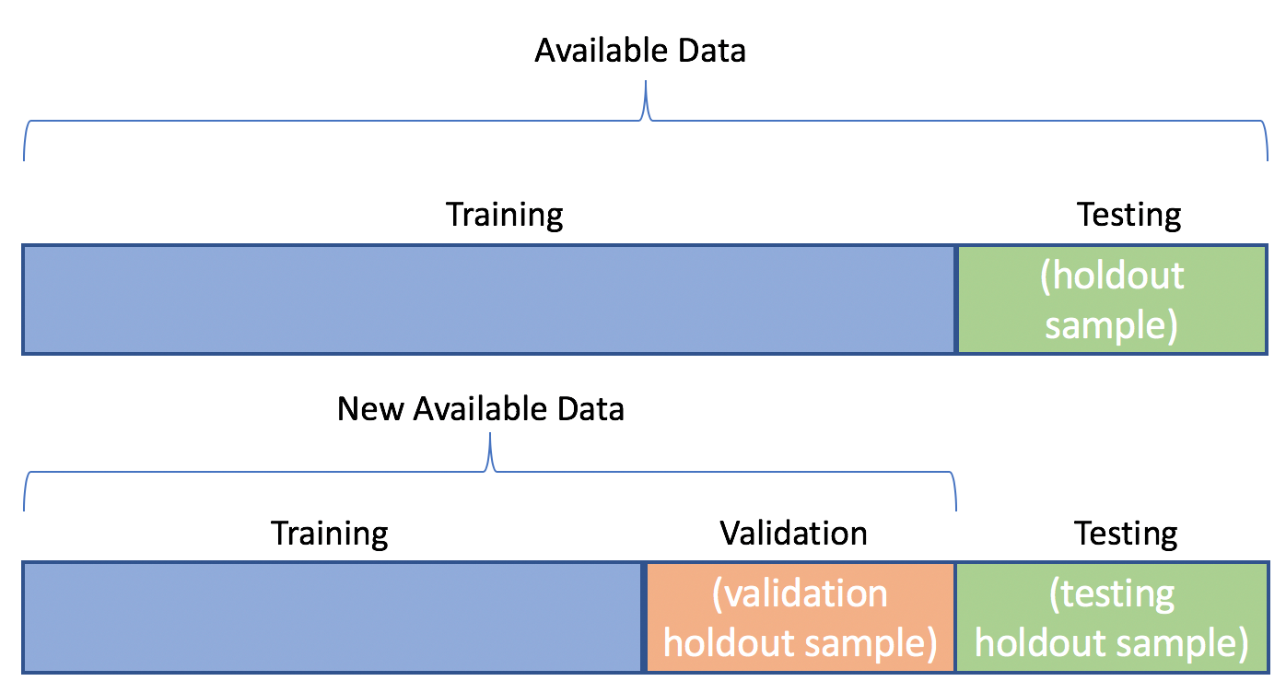
The Analysis (Continued)
Training Data: The data that is used to train the model (Teach the patterns)
Test Data: The data that the model is tested (How good the model learn the patterns?)
Cross-Validation: split the training data into k-folds and use k-1 folds (training data) to train the model and 1 fold (validation data) to validate the model.

Slide 14
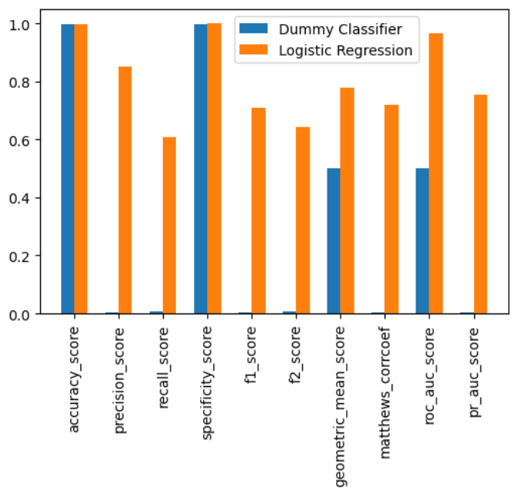
Machine Learning – Spot Check on Metrics
Some well-known metrics may not work all the time
It is good to start with a set of metrics but better is to stay with a small set of them
MCC, AUCPR and AUCROC are the best for our case

Slide 15
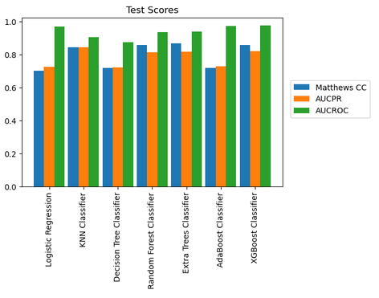
Machine Learning – First Results
Summary of test results
Shows how the models are doing
The green bar (AUCROC) is inflated
Select the best performing models:
1. Extra Trees
2. XGBoost
3. Random Forest

Slide 16
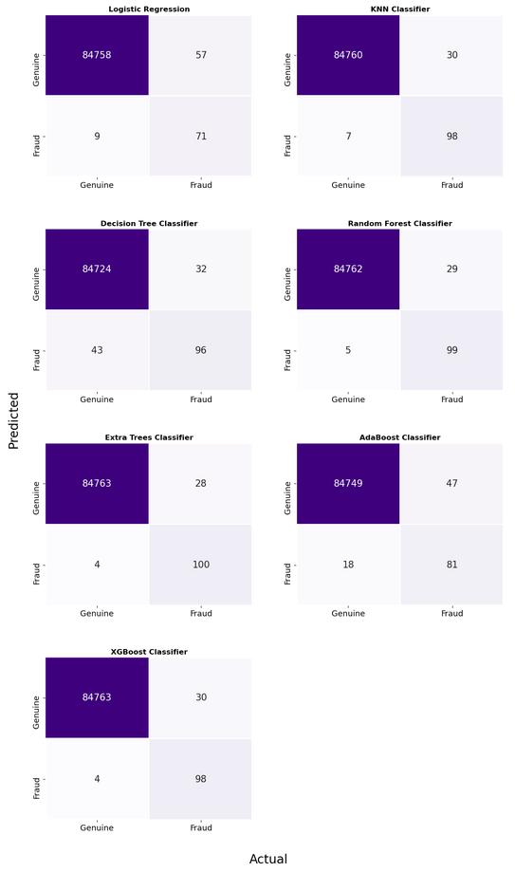
Machine Learning – What about transactions?
High performance on identifying the genuine transactions.
The false negatives (wrong alarms) are a manageable number of transactions.
Look to improve false positives

Slide 17
Machine Learning - Sampling
Sampling: Changing the class distribution in order to improve the performance of the machine learning models
Under-Sampling: Deleting observations from the majority class (genuine transactions) in order to close the gap in the class distributions (the number of observation in each class)
Over-Sampling: Increasing the number of observations in the minority class in order to close the gap in the class distributions
Hybrid Sampling: The combination of over and under-sampling.
In this study, Hybrid Sampling –SMOTEENN- is applied.

Slide 18
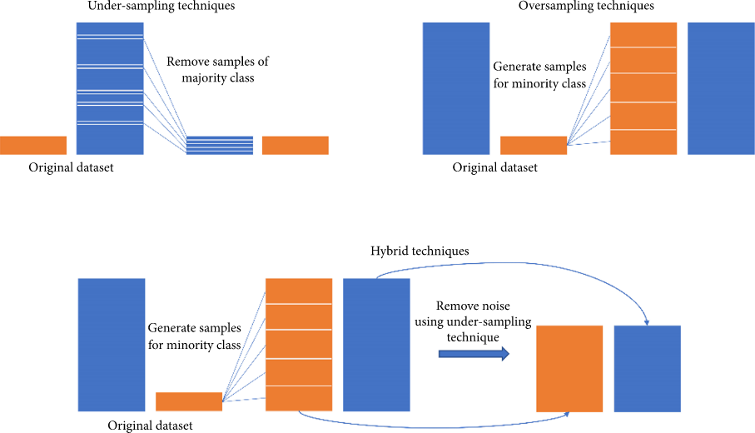
Machine Learning - Sampling (Continued)

Slide 19
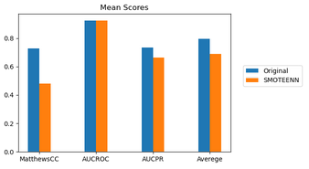
Machine Learning - Sampling (Continued)
Hybrid Sampling didn’t improve the performance
It is best to go with original data

Slide 20
Machine Learning - Optimiztion
Each model increased its performance.
The greatest increase is 22 points
The least increase is 0.2 points
 | Default Parameters | Tuned Parameters | Change
Logistic Regression | 0.756 | 0.758 | 0.002
Decision Tree Classifier | 0.734 | 0.761 | 0.027
Random Forest Classifier | 0.854 | 0.860 | 0.060
Extra Trees Classifier | 0.861 | 0.864 | 0.003
AdaBoost Classifier | 0.761 | 0.829 | 0.068
Gradient Boosting Classifier | 0.604 | 0.828 | 0.224
XGBoost Classifier | 0.850 | 0.861 | 0.011
K-Nearest Neighbors Classifier | 0.852 | 0.859 | 0.007
The best models are still didn’t change.
Extra Trees
XGBoost
Random Forest

Slide 21
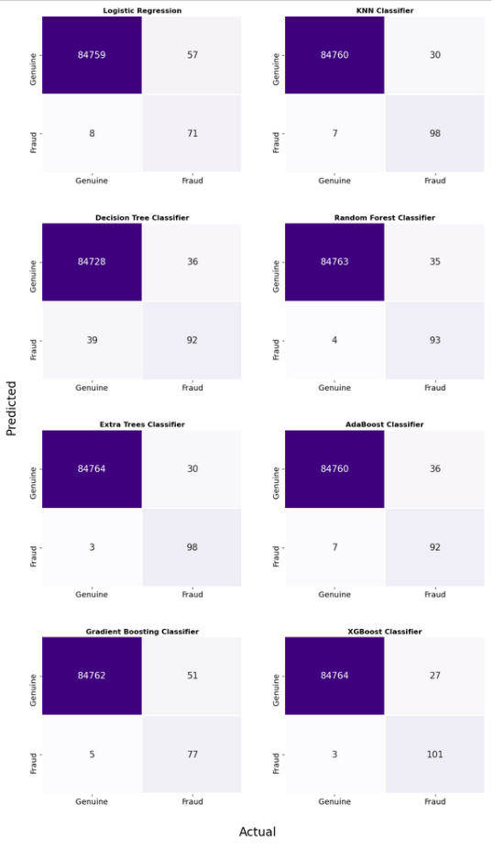
Final Evaluation
Default
Optimized

Slide 22
Conclusion
Hyperparameter optimization, overall, did have a positive effect on the performance of algorithms. Based on the test scores and the confusion matrices the top 3 algorithms are:
XGBoost Classifier (Tuned Parameters)
Extra Trees Classifier (Default Parameters)
Random Forest(Default Parameters)
Finally, the best algorithm is the XGBoost Classifier. It is able to catch 78.9% of the fraudulent transactions with less than 5 false negatives (0.00003%).

